Slide 1

CompSci 2SD3
Tutorial #1
TA: Jatin Chowdhary
DATE: January 25th, 2022

Slide 2
Introduction
Welcome to the first 2SD3 tutorial
  Tutorials have officially started
    Last week’s tutorial was a practice run (i.e. Dry run)
Most of you already know me from 2GA3
  And vice versa
In case you’re lost I can do a quick introduction
  I doubt I need to
    We are way past introductions

Slide 3
Outline
Today, we will cover the following:
  Lingering Questions
  Lecture Stuff
  Mills/Moore
  Unix Commands
  Compiling
  Makefiles
  Text Editors
  fork()
  Assignment 1

Slide 4
Lingering Questions (1)
Question: Do I have a portfolio?
  I can’t remember who asked this
Answer: SoonTM
  I’m working on it – should be done by summer.
  You should copy what I’m doing
    Next slide

Slide 5
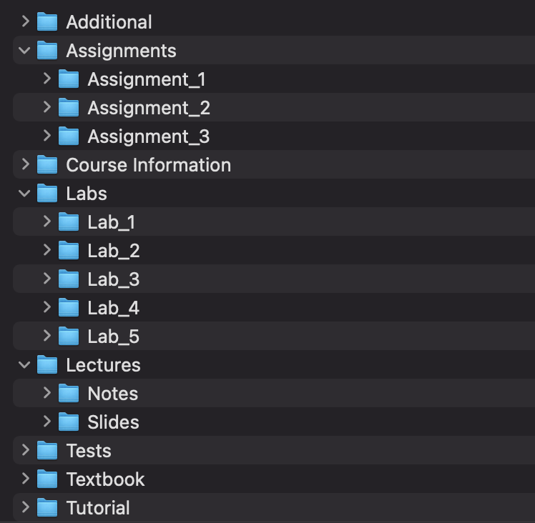
Lingering Questions (2)
All the work you have done for every course is neatly organized into their respective folders
  Anyone can easily see what you have

Slide 6
Lingering Questions (3)
Question: Why structure it this way?
  I can’t remember who asked this
Answer: Because it is effective and…
  Easy to link everything to your website, LinkedIn, Resume, etc.
    Make a website similar to this
  Recruiters and employers can easily see the work you have done over the course of your undergraduate career
  You can copy the website (above)
    It is all on Github

Slide 7
Lecture Questions
Post your questions about lecture content in the Teams channel and someone will get back to you
Avoid asking (i.e. Typing) questions in lecture, because:
  Typing is time consuming and distracting
    Instead, focus on the lecture
  Hard to convey information over text
    ‘‘A picture means a thousand words’’
      And I can’t type a thousand words in 2 mins, nor can I show code
  Breakfast
    I need to eat

Slide 8
Any Questions
(So Far)

Slide 9
Mills & Moore (1)
IMPORTANT: Stick to using Mills
  Do not use Moore, because it does not have all of the software/tools that Mills has (i.e. GO Programming Language)
Credentials
  Username: MACID@Mills.McMaster.ca
  Password: Whatever you use for Avenue, Mosaic, etc.
RSA Key Authentication:
  If it is your first time connecting to Mills/Moore/Anything, just say (i.e. Type) ‘‘yes’’ when prompted about RSA
    In a nutshell, this is the secure part of ssh, the tool we will be using to connect remotely to Mills

Slide 10
Mills & Moore (2)
How to connect to Mills?
  Secure Shell (ssh)
Secure Shell (ssh) is a remote login program
  Used to access systems, remotely
    i.e. I can be in Canada, and remotely control a computer in Australia.
Secure → Encrypted
  No one else can eavesdrop on your connection
    i.e. Communication is protected; freedom to say whatever you want
Shell → Terminal/Command-line
  This is what you will be working out of
    Note: Technologically, there is no difference between GUI and CLI

Slide 11
Mills & Moore (3)
MacOS/Linux/Unix
  Use the in-built terminal
Windows
  Download Putty, MobaXTerm, WSL, etc.
    Note: WSL = Windows Subsystem For Linux
  Windows is trash, get a *nix machine
How to use ssh?
  ssh MACID@Mills.McMaster.ca
    Note: MACID is case-sensitive
      i.e. ‘‘bill’’ is NOT the same as ‘‘BILL’’

Slide 12
Mills & Moore (4)
How to use ssh?
  ssh macid@mills.mcmaster.ca
    Note: macid is case-sensitive
      i.e. ‘‘bill’’ is NOT the same as ‘‘BILL’’
‘‘I’m typing my password, but it’s not working’’
  It is working, but the terminal does not show keyboard input in any manner or form
    This is a security feature; it prevents people from knowing the length of your password.
      It’s easier to crack a password if you know how long it is. And if you have some information about the characters, it’s exponentially easier.

Slide 13
Any Questions
(About SSH)

Slide 14
Linux/Unix Time
Now we’re going to work exclusively out of the terminal
  I recommend pulling up a terminal and following along
    You should type the commands yourself and see what happens
      Seeing is believing
I’m going to work on the left side, and you will work on the right side
  In other words, the video will be on the left, and your terminal will be on the right.
    If you’re left-handed, it’s time to start being right-handed

Slide 15
Start The Terminal
&&
Login To Mills

Slide 16
Unix Commands (1)
ls
  Show files and folders in current directory/folder
    To list files/folders in a different directory, specify it after ls
      i.e. ls folder
  Stands for list
cd
  Change to a different directory/folder
    i.e. cd directory
    i.e. cd path/of/directory
  Stands for change directory
cp
  Copy a file
    i.e cp file sameFile
  Copy a folder
    i.e. cp -r folder sameFolder
      -r stands for recursive
  Stands for copy
  Note: The name of the new file/folder has to be different
    BUT, the extension has to be the same – an image (PNG) cannot become a spreadsheet (XLSX)

Slide 17
Unix Commands (2)
mv
  Move a file/folder to a different directory/folder
    i.e. mv file path/to/directory
    i.e. mv folder path/to/directory/folder
  Stands for move
  Interestingly, mv is also used for renaming
    Why? Because of how file/directory tables work
      Next slide

Slide 18
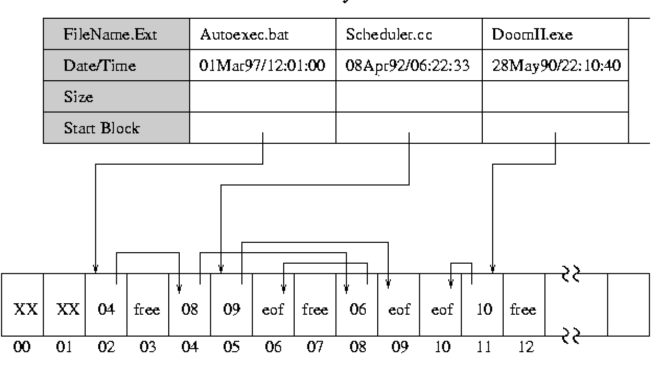
Unix Commands (3)
mv
  Interestingly, mv is also used for renaming
    Why? Because of how the File Allocation Table (FAT) works

Slide 19
Unix Commands (4)
mkdir
  Make a new (empty) folder
    i.e. mkdir folder
  Make a bunch of new (empty) folders
    i.e. mkdir folder1 folder2 folder3
  Make new (empty) folders inside each other
    i.e. mkdir -p folder/anotherFolder/anotherOne/andAnotherOne
  Stands for make directory
touch
  Can be used to make a new (empty) file
    i.e. touch file.txt
    i.e. touch hello.c
    i.e. touch program.java
  In reality, touch is used to change file access and modification times
    Don’t worry about this for now

Slide 20
Unix Commands (5)
Commands are case sensitive on Mills
  mkdir is the same as mkDIR
  touch is the same as ToUcH
Manual (man) pages
  Great resource for finding more information about a command (or almost anything else)
    If you want to know more about the mkdir command, then you type: man mkdir
    If you want to know more about the touch command, then you type: man touch

Slide 21
Unix Commands (6)
Flags
  Used to specify alternate options
    List all (hidden) files in a folder/directory
      $ ls -a
    List all files in a table-like format
      $ ls -l
    List all hidden files in a table format
      $ ls -la
    Copy a folder and all of its contents
      $ cp -r folder sameFolder
    Move/Rename a folder
      $ mv -r folder sameFolder
    Make empty folders inside each other
      $ mkdir -p folder1/folder2/folder3
Use the man pages to figure out what flags are supported by a command, and how to use it.
  Note: The man pages were not written for undergraduate students. So you will find it cumbersome to use. However, once you get the hang of it, you’ll appreciate it more.
    Feel free to Google how to do `X` command, and then supplement it with the man pages.

Slide 22
Unix Commands (7)
More commands:
  locate
    Find filenames quickly
      i.e. locate nameOfFile
      i.e. locate stdio.h
      i.e. locate jiffies.h
  grep
    Looks at the contents of files and returns/prints lines that match a pattern
      i.e. grep ‘‘pattern’’ file.txt
      i.e. grep -irn ‘‘pattern’’ .
        Useful for online tests
    Stands for global regular expression
More commands:
  find
    Recursively traverse a directory; good for listing all files in a directory
      Also good for piping (i.e. Providing input to another command)
    i.e. find folder
    i.e. find folder1 folder2
  head / tail
    List the first / last `X` number of lines in a file
      i.e. head -10 file.txt
      i.e. tail -10 file.txt

Slide 23
Unix Commands (8)
Piping commands/input
  Connects two or more commands, where one command provides input to the other command
    Expands the functionality of basic commands
  Examples:
    Only show the first 10 entries of ls
      $ ls | head -10
    Only show the last 10 entries of find
      $ find folder | tail -10
    Only list files that were made/modified in January
      $ ls -la | grep -i ‘‘Jan’’
      # -i means to ignore case
    Search the find man pages for a ‘‘pattern’’
      $ man find | grep ‘‘recurs’’
      # This is pattern matching

Slide 24
Any Questions
(About *nix)

Slide 25
Transferring Files (1)
Secure Copy
  scp [Host machine → Remote server]
    Copy a file from host machine (you) to remote server (mills):
      General format: scp file user@remote.server.ca:~
        i.e. scp assignment1.c chowdhaj@mills.mcmaster.ca:~
    Copy a folder (and all of its contents) from host machine (you) to remote server (mills):
      General format: scp -r folder user@remote.server.ca:~
        i.e. scp -r final_project chowdhaj@mills.mcmaster.ca:~
  Note: These commands need to be executed on your machine, and not the remote server. Regardless of which way files are being sent, type the commands on your machine’s terminal, and not the remote server

Slide 26
Transferring Files (3)
Secure Copy
  scp [Remote server → Host machine]
    Copy a file from a remote server (mills) to your machine (you):
      General format: scp user@remote.server.ca:/path/file.txt /directory/on/host
        i.e. scp chowdhaj@mills.mcmaster.ca:~/code/assignment1.c ~/Desktop
    Copy a folder (and all of its contents) from a remote server (mills) to your machine (you):
      General format: scp -r user@remote.server.ca:~/path/folder /directory/on/host/machine
        i.e. scp -r chowdhaj@mills.mcmaster.ca:~/code/final_project ~/Desktop/2SD3
  Note: These commands need to be executed on your machine, and not the remote server. Regardless of which way files are being sent, type the commands on your machine’s terminal, and not the remote server

Slide 27
Transferring Files (3)
Secure File Transfer Protocol
  sftp
    General format: sftp user@remote.server.ca
      i.e. sftp chowdhaj@mills.mcmaster.ca
  0. Can only be used to transfer files/folders from a remote server to your machine
  1. Once the connection has been established, use commands like ls and cd to list and change directories, respectively
  2. Then, use get to retrieve files/folders:
    Copy file from remote server to host machine:
      i.e. get someFile
    Copy folder (and its contents) from remote server to host machine:
      i.e. get -r someFolder

Slide 28
Alias
Constantly typing the entire destination address (or remote server) is cumbersome
  Typing long commands with flags and arguments is also tedious
Use aliases to shorten or abbreviate long commands
  i.e. alias mills-ssh="ssh chowdhaj@mills.mcmaster.ca"
  i.e. function mills-scp() {scp -r $1 chowdhaj@mills.mcmaster.ca:~ ;}
Creating aliases is more-or-less the same for every shell
  However, depending on what shell is being used, a different file needs to be edited
    i.e. On Z-Shell (zsh), look for .zprofile in the home directory
      Navigate to the home directory via: cd ~
      Use ls -la to list all (hidden) files
  You will need to do some research to figure out which shell you are using, and subsequently, which file needs to be modified
Note: Don’t forget to source the file after making changes
  i.e. source .zprofile

Slide 29
Text Editors
In order to edit (text) files on Mills, you will need to use a text editor
  For example:
    nano nameOfFile.txt
    vi/vim fileName.c
    emacs someFile.java
Which one to use?
  nano is very simple and easy to use
  vi/vim is more complicated has a moderate learning curve
  emacs is extremely complicated and has a steep learning
The steeper the learning curve, the more features it has
For beginners, stick to nano – it is simple, quick, and easy

Slide 30
C Programming (1)
Basic boilerplate for C programs
  main() function
    Return type
      void
    Parameters
      int argc, int * argv[]
      void
  The main() function is very special because it is:
    1. The entry point. In other words, it is the first function that is executed
    2. Quite versatile. The return type and parameters do not have to be strictly followed
Examples:
  boilerplate_minimal.c
  boilerplate_void.c
  boilerplate_parameters.c

Slide 31
C Programming (2)
How to compile C programs?
  Use `gcc` to compile C source files
`gcc` stands for GNU C Compiler
  What does GNU stand for?
    It’s a lame nerd joke about Unix and recursion
To compile your C source files to executables, type the following into the terminal:
  gcc program.c -o program
    gcc → Compiler
    program.c → Name of the C source file
    -o → Output flag
    program → Name of the executable

Slide 32
Spawning A Process
Processes can use `fork()` to spawn a child process
  A child process is nearly identical to its parent process
    For all intents and purposes, the child is a copy of the parent process – it is like mitosis/meiosis in biology
  The process that calls `fork()` is the parent process, and the newly created process is the child process
  `fork()` returns a value of 0 to the child process, and to the parent process it returns the PID of the child process
  Note: `fork()` is a system call
Learn how `fork()` works via the man pages
  Type the following into the terminal:
    man -s2 fork
  man pages are the best resource for *nix machines
Refer to the following:
  fork.c
    How to compile it: gcc fork.c -o fork

Slide 33
THE
END

